Slide 1
Tourism Project

Slide 2
Background and Context
Visit With Us is a travel and tourism company that is looking to expand into the wellness tourism market. Currently, there are 5 types of packages the company offers - Basic, Standard, Deluxe, Super Deluxe, and King. Data collected over the last year indicates that 18% of the customers purchased the packages. During that same period, marketing costs were quite high because customers were contacted at random without any data driven decision making.
The company is now planning to launch the Wellness Tourism Package. Wellness Tourism is defined as travel that allows the traveler to maintain, enhance or kick-start a healthy lifestyle, and support or increase one's sense of well-being. This time around, the company wants to harness the available data of existing and potential customers to make the expenditure more efficient.
Here, we are going analyze the company's data and information to provide recommendations for policy makers and the marketing team and also, build a model to predict potential customers who are more likely to purchase the wellness tourism package.

Slide 3
Overview of Dataset problems and How the Analysis will be Approached to Overcome
The dataset that we have is relevant to the characteristics of customers as it relates to the current travel packages offered by the company but we want to use this data to make predictions about a new travel package, wellness travel or tourism. Since the dataset that is going to be used in this analysis is not directly relevant to the predictions that are sought, the data will need to be weighted to conform it into a representative reflection of the population of interest. This will be done by making an "Educated Guess" about the demographics and characteristics of wellness tourism travelers, and then weights assigned employing a standardized process to give preference to those samples that most closely match our guesses. Utilizing the weighted dataset, predictions will be made against the data, and those predictions will be utilized to make inferences about which customers are ripe for marketing wellness tourism to and how best to pitch wellness tourism to customers based upon their demographics.

Slide 4
Metrics Employed and Measurements of Success
The ideal machine learning algorithm among DecisionTreeClassifier, BaggingClassifier, RandomForestClassifier, AdaBoost, GradientBoost, XGBoost, and Stacked models utilizing a sample weight array to conform the data so that it is applicable to wellness tourism will be selected based upon the following criteria:
Consistency of its Accuracy score with a predicted accuracy score based upon greater than the mean sample weights.
The highest available recall score to aim for the most correct predictions that lead to purchases of the wellness tourism package.
Beyond predicting customers who would are more likely to purchase the wellness travel package, the predictions made against the weighted dataset will be used to determine ideal parameters to guide customer interactions.

Slide 5
What is/are the objectives of the problem(s) that are addressed in your project (Classification/ Regression/ Clustering Rules/ Text Analytics/ Reinforcement learning etc...)?
We choose 6 models for our classification problem because in our dataset target variable is in categorical format so, when class label is in categorical then this problem is related to classification. Models are given below that we have choose for our prediction.
Decision Tree
Bagging Classifier
Random Forest Classifier
Ada boost Classifier
Gradient Boosting Classifier
XGBoost Classifier

Slide 6
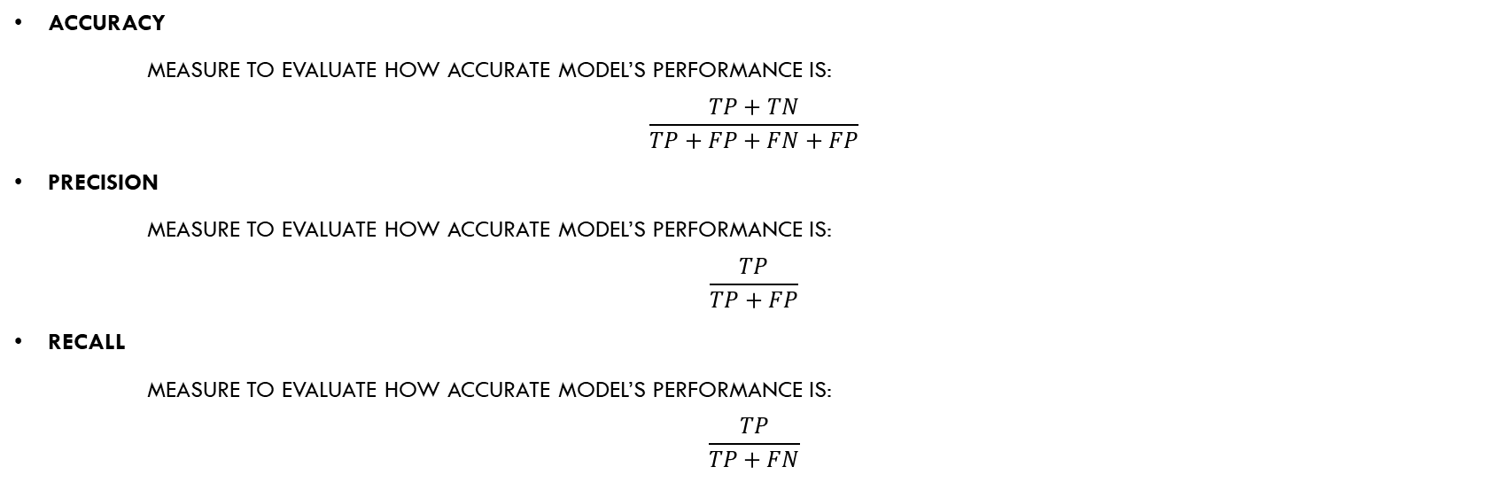
We will measure the performance of each models on different metrics that shown below:
Accuracy
Measure to evaluate how accurate model’s performance is:
$$\frac{TP+TN}{TP+FP+FN+FP}$$
Precision
Measure to evaluate how accurate model’s performance is:
$$\frac{TP}{TP+FP}$$
Recall
Measure to evaluate how accurate model’s performance is:
$$\frac{TP}{TP+FN}$$

Slide 7

F₁
Provides information of both sides TN and TP
$$2∗\frac{Precision∗Recall}{Precision+Recall}$$
$where TP=True Positive$
$FP=False Positive$
$TN=True Negative$
$FN=False Negetive$
Confusion Matrix

Slide 8
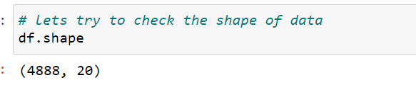
Characterization of the data set: number of attributes; has/ does not have missing values; number of examples etc. Clean and remove the missing values from the dataset. Provide a clear strategy?
We have a data set of Tourism. This is not a huge dataset so, we will explore the dataset to know more about the data shape, descriptive analyses, Statistical analysis, Univariate ,bivariate analysis, correlation, missing values, dtypes, column names etc.
Let’s try to look the shape of data:

Slide 9
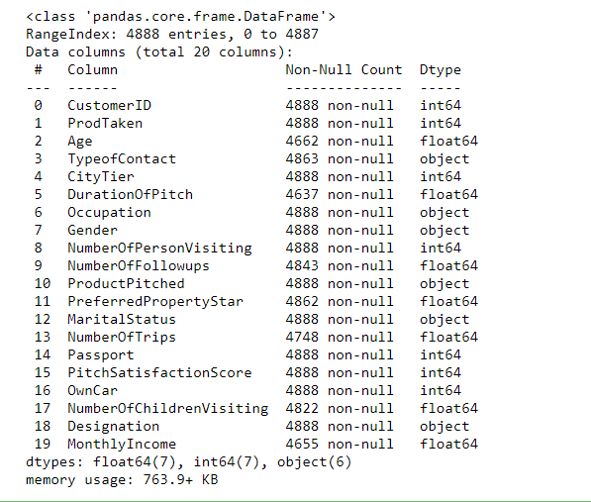
Lets check the column name and information about the data
Now we Exploring the column names is an important aspect of EDA. • We can see that columns are not null. The data types of all columns are int, float and object data type. By closely observing the data and description given about each column attribute we can say that:
Numeric data columns are Age, MonthlyIncome and DurationOfPitch.
Ordinal Categorical columns are TypeofContact , Occupation, Gender, ProductPitched, MaritalStatus, and Designation.
Nominal Categorical columns are CustomerID , ProdTaken, CityTier, NumberOfPersonVisiting, NumberOfFollowups, PreferredPropertyStar, NumberOfTrips, Passport, PitchSatisfactionScore , NumberOfChildrenVisiting and Owncar

Slide 10
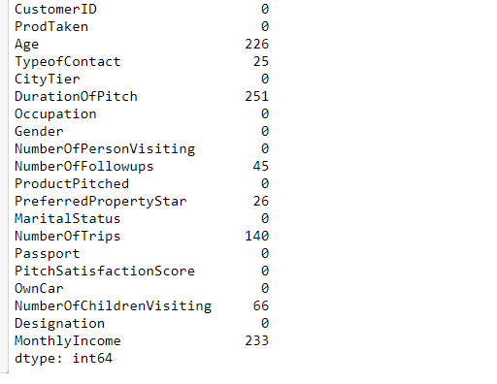
From this we can see that too much missing values in every columns. So we will handles these missing values according our problem.
Now are moving toward the data cleaning part so that we can clean our data and move forward.

Slide 11
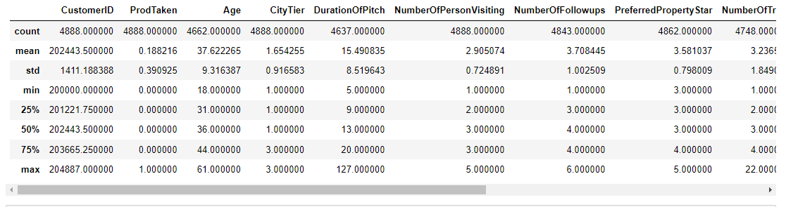
Descriptive Analysis
The Exploratory Data Analysis is more important method which is describe method shows basic statistical characteristics of each numerical feature (int64 and float64 types):
Number of non-missing values, mean, standard deviation, range, median, 0.25 and 0.
We can see the Min, Max, mean and standard deviation for all key attributes of the datase75 quartiles.

Slide 12
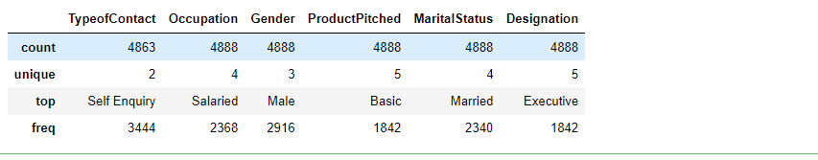
Descriptive Analysis on Non Numeric
Previously we see that descriptive analysis on int or float type but not in numeric.
In order to see statistics on non-numerical features, one has to explicitly indicate data types of interest.
This give us count of values, unique values, top and frequency of values

Slide 13
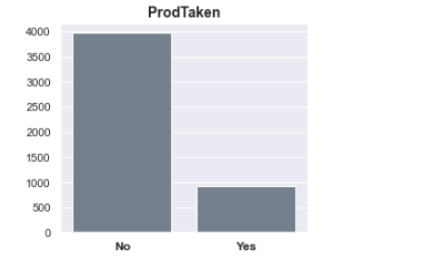
Data Visualization(Univariate)
In this section, we will visualize all the columns and check the distribution and relationship with others columns and also we will get more analysis from the graph.
Uni stands for "one," meaning that, there is just one sort of variable in the data. Univariate analysis' main purpose is to characterize the data. The information will be collected, analyzed, and a pattern will be identified
Now let us see that those customers which are visiting how many number of customer purchased the package.
Whether the customer has purchased a package or not (0: No, 1: Yes) Most people are not purchasing anything as you see.

Slide 14
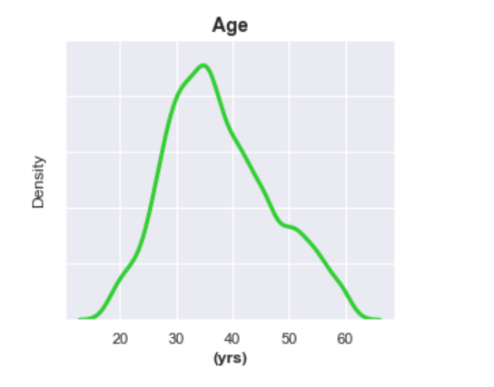
Now let us see through the curve that in which age people purchase most packages
From above figure Age of customer are mostly between 25 to 40 and a very small number people which is less then 20 years old and more than 60 years old.

Slide 15
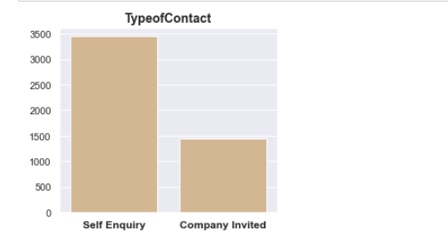
Let’s Now try too look that how customer was contacted (Company Invited or Self Inquiry)
Most of people are contracted as a self Enquiry and average number of people are company invited.

Slide 16
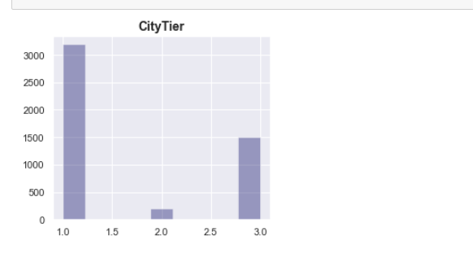
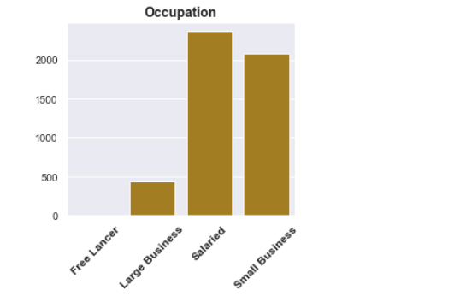
Now we can plot the bar graphs so that we can understand that city tier depends on the development of a city, population, facilities, and living and most of are come from the population side.
Again through bar graph we are seeing that most of Occupation of customer are Salaried based or have a small business.
And a very low people have occupation of Large Business.

Slide 17
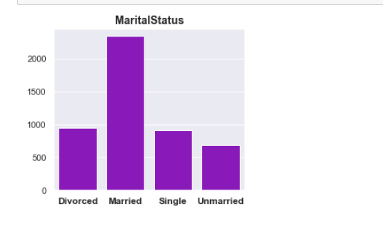
Marital status of customer which are going to trip is Married and others like Single, Divorced or Unmarried are approximately equally.
But Married people are most going to trip.
There are almost 70 percent of people are married.

Slide 18
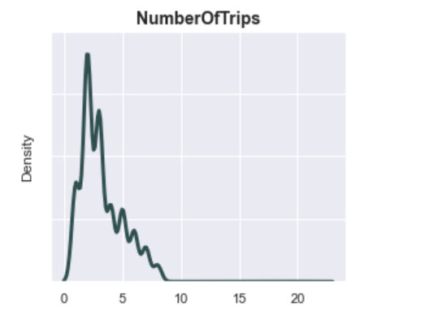
Average number of trips in a year by customer are between 2 to 5 and maximum number trips of people are around about 10.

Slide 19
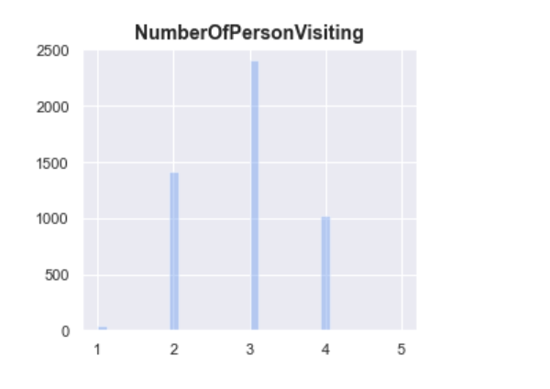
From above figure Total number of persons planning to take the trip with the customer are 2 to 4
Total number of children with age less than 5 planning to take the trip with the customer.

Slide 20
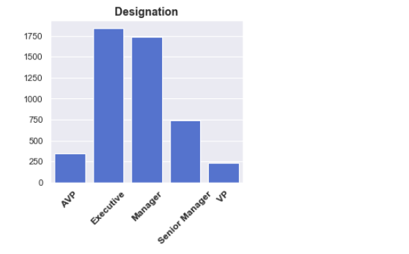
As you can see from the bar plot that Most designation of the customer in the current organization are as a Executive or as a Manager.
And a very low at AVP or VP

Slide 21
INFERENCES FROM UNIVARIATE ANALYSIS
Most people are not purchasing anything.
Average number of age of customer are mostly between 25 to 40 and a very small number people which is less then 20 years old and also less number of people more than 60 years old.
Most of people are contracted as a self Enquiry.
Most number of are people come from the population side.
Occupation of customer are Salaried based or have a small business.
Married people are most going to trip.There are almost 70 percent of people are married.
Average number of trips in a year by customer are between 2 to 5.
Total number of children with age less than 5 planning to take the trip with the customer.
Most designation of the customer in the current organization are as a Executive or as a Manager.

Slide 22
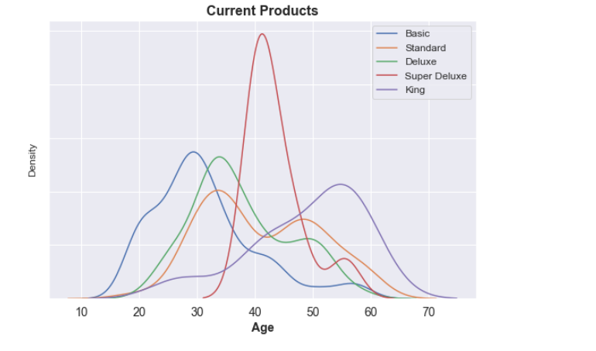
Exploratory Data Analysis of Current Product Sales and Customer Trends
Below, customer trends for current product sales are visualized and explored to gain insight into current sales operations. Later on in this notebook, these same visualizations will be compared against predicted wellness tourism customers to attempt a differentiation.
Below, customer trends for current product sales are visualized and explored to gain insight into current sales operations.
As we see from this graph that the customer has most purchased a package is Super Deluxe and age of those peoples who purchases most these packages are between 30 to 50.

Slide 23
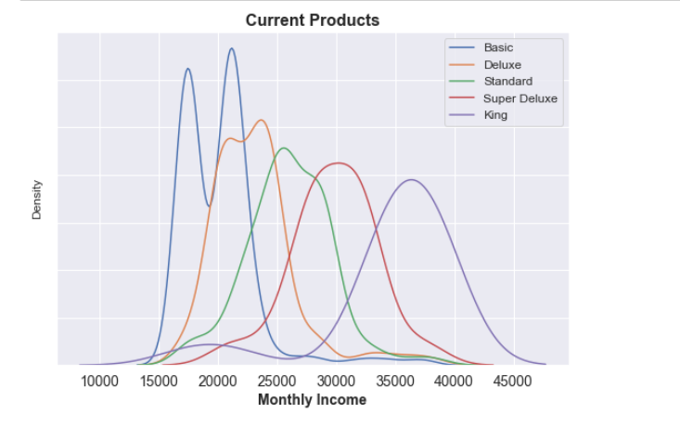
Observations
Basic package: popular with customers in their 20s, 30s, and 40s Standard and Deluxe packages: skewed towards customers in their 30s and 40s Super Deluxe package: popular with customers in their 40s and 50s King package: popular with customers in their 40s and 50s
Those customers has most purchased a Basic package whose Monthly income is between 15000 to 25000. And those people purchase the king package whose monthly income between 35000 to 45000 which is quite high range.

Slide 24
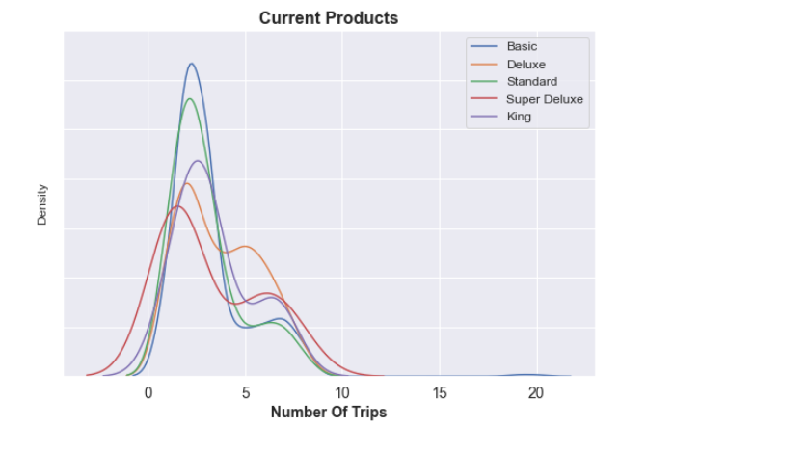
Observations
Basic Package: Popular with customers with income range between 15k and 25k Deluxe Package: Popular with customers with income range between 20k and 30k Standard Package: Popular with customers with income range between 20k and 35k Super Deluxe Package: Popular with income range between 25k and 35k King: Popular with customers with income range between 30k and 45k.
Average number of trips are between 0 to 5 in a year and those trips are basic package trips.

Slide 25
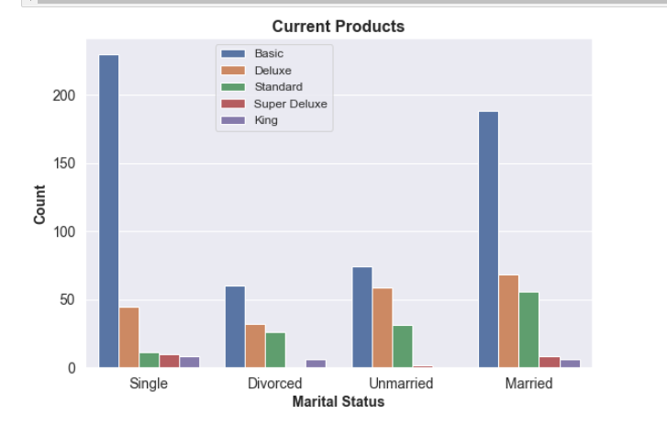
Observations
This plot speaks for itself. Executives: Basic package, Manager: Deluxe Package, Senior Manager: Standard Package, AVP: Super Deluxe, VP: King. Real life isn't like this, but for the dataset provided, a customers Designation is all that would be needed to determine with level of package to pitch.
A majority of customers required 3-5 follow-ups before making a purchase

Slide 26
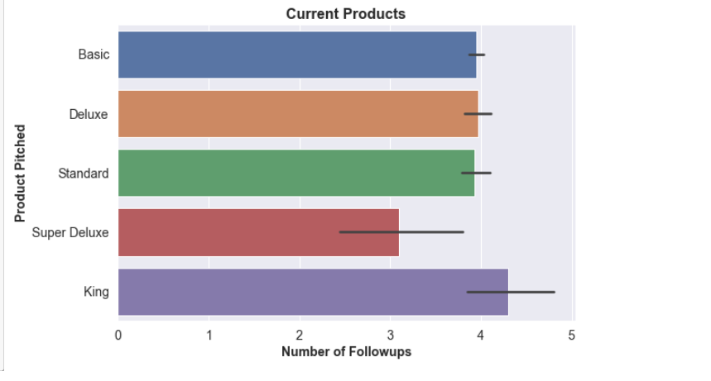
Observations
A majority of customers required 3-5 follow-ups before making a purchase.
Marital status of customer who has purchased a basic package no Basic, Deluxe, and Standard packages on average required 4 follow-ups before purchase made. Super Deluxe on average required 3 follow ups before purchase made. And King on average required 4-5 follow-ups. ** there may be an indicator here on the Super Deluxe package performance - the lower than average follow-ups may indicate that low sales might be due to not following up enough.st are Single and Married.

Slide 27
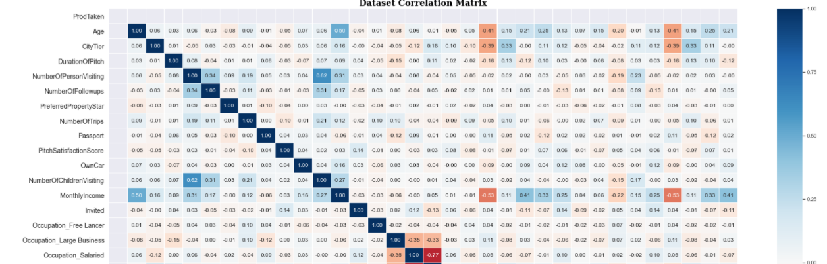
EXPLORATORY DATA ANALYSIS (BIVARIATE)
This graph is of correlation between variables in the form of heat map.
There is a high correlation between Age ,Monthly income and Number of children visiting columns. They make any increase the model’s performance.

Slide 28
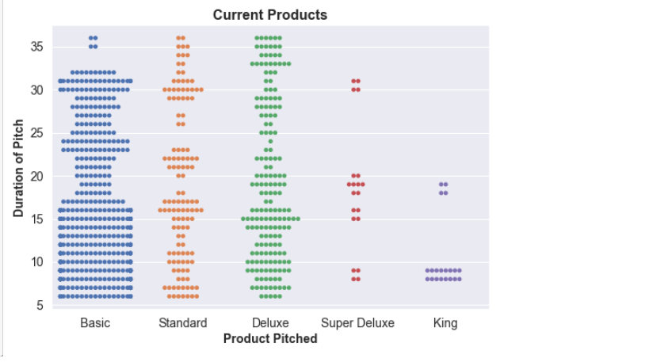
EXPLORATORY DATA ANALYSIS (BIVARIATE)
Majority of customers own a car, but those that do not are likely to purchase lower end packages, especially the basic package.
This plot demonstrates that there was not a set duration of pitch and that each pitch went from about 5 to up to 35 minutes. For super deluxe and king packages, it is likely that the durations would have followed suit had there been a greater sample of customers who purchased those packages.

Slide 29
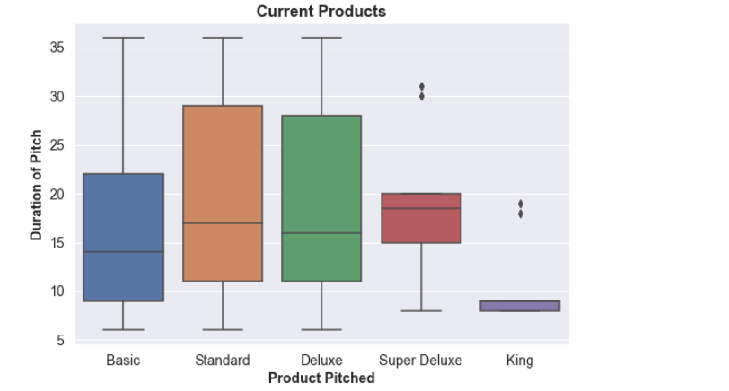
EXPLORATORY DATA ANALYSIS (BIVARIATE)
The mean pitch durations for the standard travel package is statistically different than the mean duration for the Basic package but is not different than the Deluxe or Super Deluxe, even though those two packages have a statistically similar mean to the basic travel package.
This implies that there is not in-fact much difference between the means, but an overall difference in the IQR of the two distributions.
The mean pitch duration for the king travel package was statistically less than all other packages.

Slide 30
INFERENCE FROM BIVARIATE ANALYSIS
There is a higher correlation in Product pitched basic, Product pitched Deluxe, Product pitched King, Product pitched Standard and Number of children visiting columns.it impact on performance as compare to others.
Correlation coefficient of Age, city tier and product pitched basic variable is negative and close to zero so we can drop the variable. Correlation coefficient are close to zero so we can drop these variables as well.
There was not a set duration of pitch and that each pitch went from about 5 to up to 35 minutes. For super deluxe and king packages, it is likely that the durations would have followed suit had there been a greater sample of customers who purchased those packages.
The mean pitch durations for the standard travel package is statistically different than the mean duration for the Basic package but is not different than the Deluxe or Super Deluxe, even though those two packages have a statistically similar mean to the basic travel package.

Slide 31
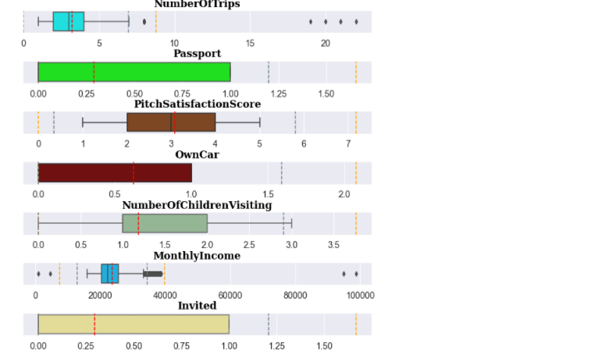
Try to detect the outliers
There is some outliers here which don't need to be treated for decision tree, bagging, and random forest. Normally they should be treated when using Boosting models because those models are not robust to outliers due to the algorithm in which successive models place preference on the worst performing for successive iterations, which could lead to model overfitting.

Slide 32
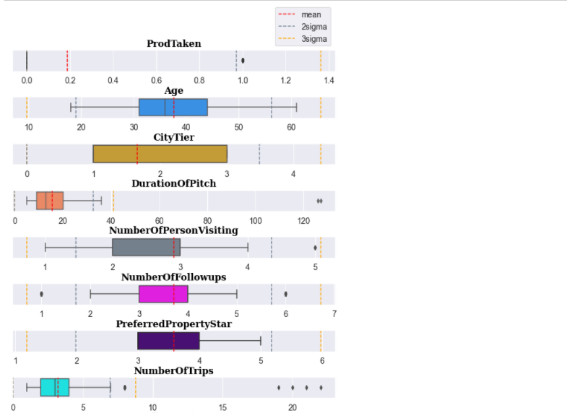
For several reasons, the outliers are not going to be treated in this case:
1) There's not many outliers, and importantly,
2) outlier treatment might affect the outcome of the weighting and analysis performed here.
Outliers will be left untouched though it will be presumed that Boosting may have more overfitting than they would if the outliers were treated.

Slide 33
Observations
The basic travel package has the highest conversion rate, at about 30% of total pitches, followed by the Standard at about 15%, then the Deluxe (10%) and King (8%). The super-deluxe package had the worst performance, though it is not clear why.
It may be that the super deluxe package is not appealing to customers and should not be offered anymore, or the pitch needs to be improved upon and customers selected in a more methodical way. For all of the lower performing packages, it is recommended that their performance be further studied to find areas of improvement.

Slide 34
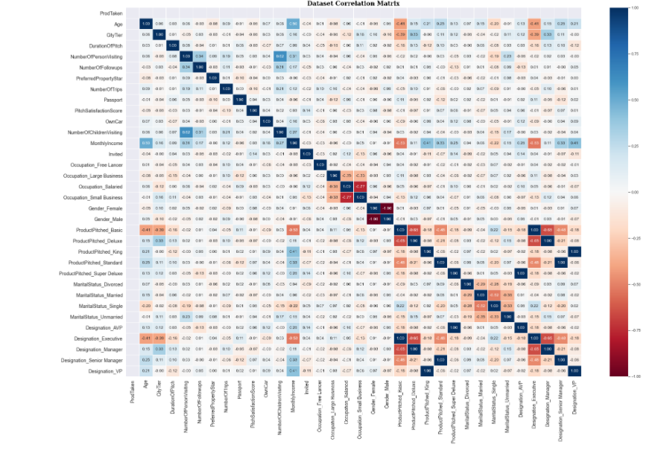

Slide 35
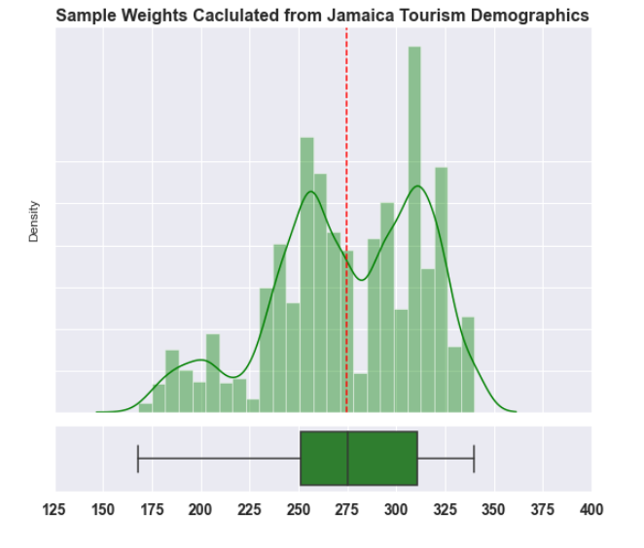
Sample Weights Calculated from Jamaica Tourism Demographics
As demonstrated in the graph, the sample-weight distributions are spread out pretty well, though they are left-skewed toward higher weights.

Slide 36
Prediction of reliable model accuracy from sample weights
Observation
It is presumed that a good model with good predictions for wellness tourism from the sample weights and current travel packages dataset should be about 90% accurate (meaning that about 10% of the predictions do not fit the educated guess of the wellness tourism demographics).
Decision Tree Classification Model
Decision Tree accuracy on the testing data was at about 85% with is slightly lower than the 90% expected rate. The recall is quite low, at around %40 (worse than what would be expected for a random / chance event). The Feature importance plot demonstrates that a little more than half of the features were used toward making predictions in this model.

Slide 37
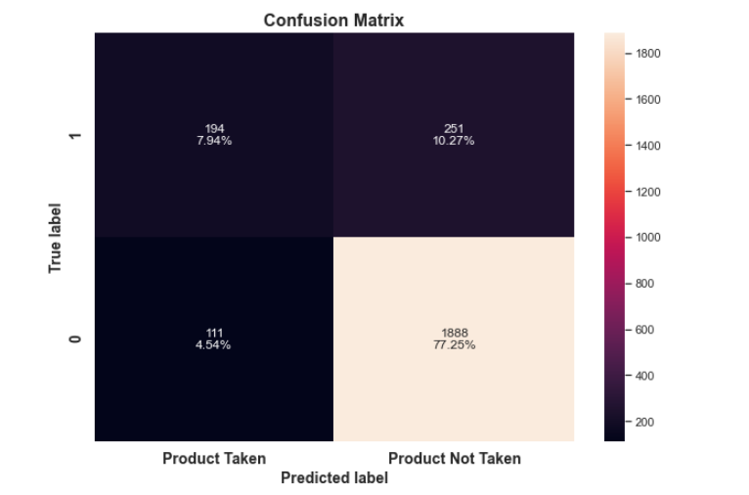

Slide 38
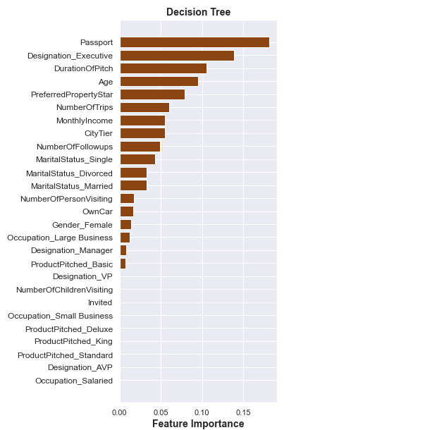
Feature Importance
Most important feature are Passport and Designation Executive and duration of pitch Age.
And which are not important for Decision Tree are ProductPitched_Basic, Designation Manager and Gender Female

Slide 39
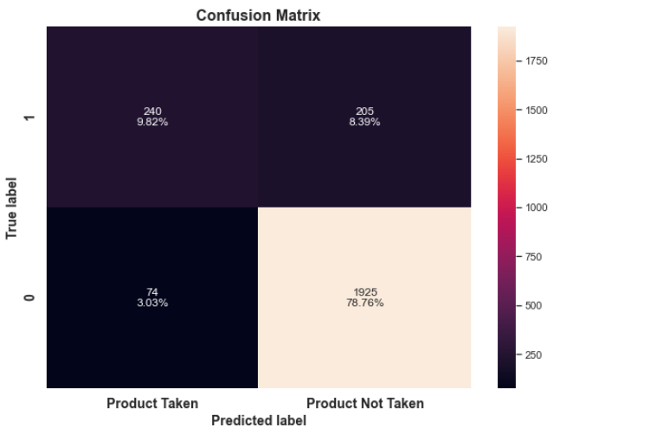
Bagging Classifier
Accuracy of the Bagging Classifier model was at about 90% which was what was predicted as a reasonable accuracy for the weighted model. Recall saw an improvement over the Decision Tree model, but it is still quite low (50%) at about equal to a random event. Latency of the prediction is much greater than the decision tree, but it is not clear whether latency is important here.

Slide 40
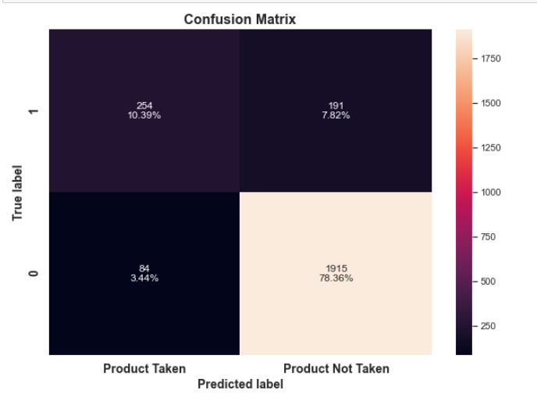
Random Forest
The Random Forest model has a near 90% accuracy rate consistent with the expected accuracy for the weighted model, similar to Bagging. Recall is better than random at 57%, though not by much. Analysis of feature importance indicates that all features contributed to the model, except Designation_VP (and most significantly contributed).

Slide 41
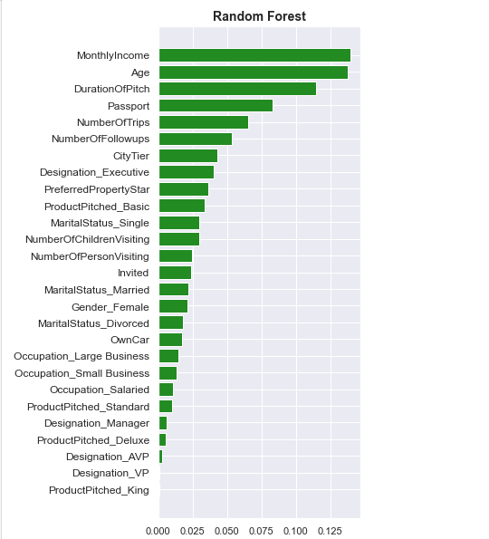
Feature Importance
Most important feature are Passport and Monthly Income and Age and duration of pitch.
And which are not important for Random Forest are Own Car, Designation Manager and Gender Female.

Slide 42
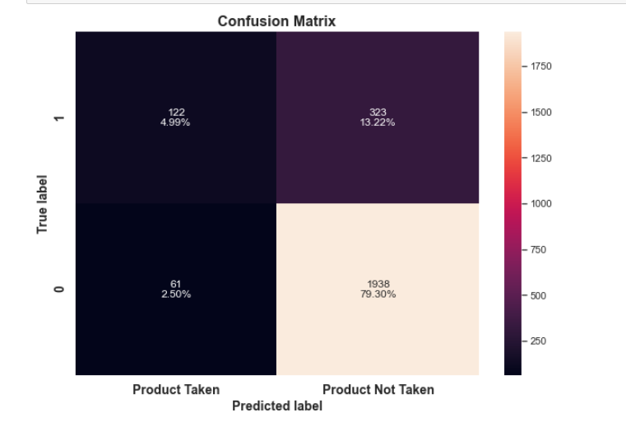
Ada boost
Model performance is terrible, with recall at 28%. This may be due to not having treated outliers, but more than likely, the algorithm performs in a way that just doesn't mesh well with the sample weights and distributions of the features of this dataset.

Slide 43
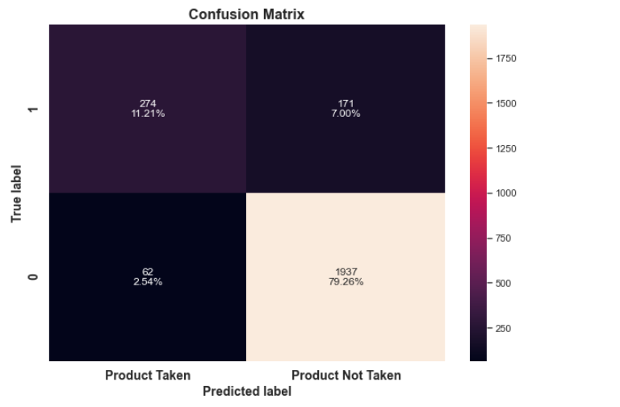
Gradient Boosting Classifier
This model has slightly higher than predict accuracy but that is not necessary a bad thing. Recall at 63% is an improvement over other models (especially the 23% offered by AdaBoost). The model is using most features in its prediction.

Slide 44
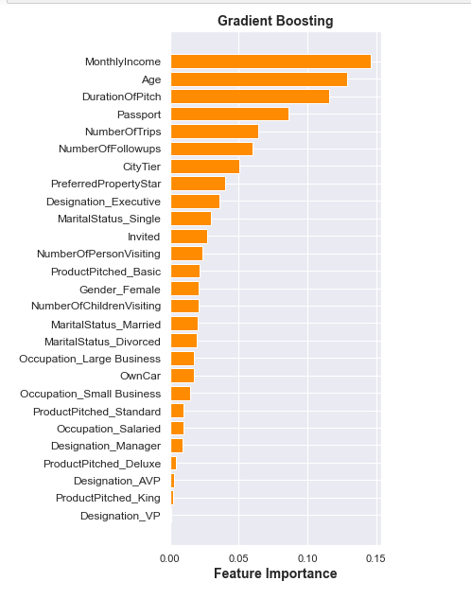
Feature Importance
Most important feature are Passport and Monthly Income and Age and duration of pitch.
And which are not important for Gradient Boosting are Own Car, Designation Manager and Gender Female.

Slide 45
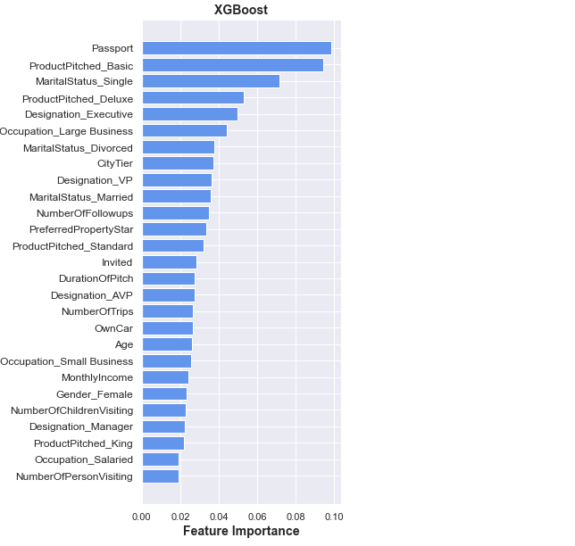
XGBoost Classifier
Accuracy near prediction 90% but recall lower than the Gradient Boosting model. Feature importance indicates that the model is using all of the features of the dataset in making its predictions.

Slide 46
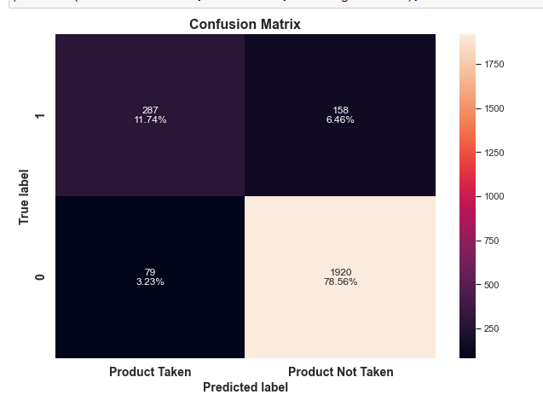
Stacking Classifier
The stacking classifier is achieving a 90% accuracy rate, which is where it should be based upon predictions using the sample weights. Most import, the stacking classifier is achieving a near 72% Recall, which is the best model and therefore the model that will be used going forward. Latency was sacrificed in using the stacking classifier, which is expected considering that it is employing 4 models to make its predictions.

Slide 47
Summary of Model Performances
All of the models except the Decision Tree and Adaboost classifier appear to be slightly overfitting. Adaboost should not be seriously considered given its recall scoring.
For the remainder of the models, the appearance of overfitting may indicate that the sample weights are being countered by the nature of the error correcting process of the algorithms.
The Stacking model is definitely the best performing model here and predictions from this model will be utilized going forward to Exploratory Analysis of the predicted subset.

Slide 48
Summary and Recommendations for the Future Business
Age:
Basic - Predominately in 20s, also 30s and 40s
Standard & Deluxe - Predominately in 30s, also 40s
Super Deluxe - Predominately in 40s, also 50s
King - 30s, 40s, but predominately in 50s
Income:
Basic - 15k - 25k
Deluxe - 20k - 30k
Standard - 20k - 35k
Super Deluxe - 25k - 35k
King - 30k - 45k

Slide 49
Marital Status:
Basic - Single, Divorced, Unmarried, & Married
Deluxe - Single, Divorced, Unmarried, & Married
Standard - Divorced, Unmarried, & Married
Super Deluxe - Single & Married
King - Single, Divorced, & Married
City Tier
Basic - 1, 2, & 3
Deluxe - 1 & 3
Standard - 1 & 3
Super Deluxe - 3
King - 1 & 3
Gender No Gender Specificity

Slide 50
Person
Basic, Deluxe, Standard, & King - 2, 3, & 4
Super Deluxe - 2 & 3
Occupation
Basic, Deluxe, Standard, & King - Salaried, Small Business, and Large Business
Super Deluxe - Salaried & Small Business
Freelancers very unlikely to purchase travel package
Preferred Property Scores
Basic - 3, 4, & 5
Deluxe, Standard, and Super Deluxe - Predominately 3
King - 3 & 4 but predominately 4

Slide 51
Passport
Basic more likely for International Travel
Designation
Basic - Executive
Deluxe - Manager
Standard - Senior Manager
Super Deluxe - AVP
King - VP
Follow-ups
Expect 3-5 follow-ups before purchase
On Average:
Basic, Deluxe, Standard, & King - 4 follow-ups
Super Deluxe - 3 ** There is some indication that by increasing follow-ups to at least 4, this may result in an uptick in sales.

Slide 52
Pitch Satisfaction Score
There appears to be a problem with the survey for pitch satisfaction which is indicating satisfaction scores that are inconsistent with purchasing behavior. This may be due to a misunderstanding in which rating is god or bad. Recommend switch to Excellent, Good, Average, Poor scoring to get better feedback.
# of children visiting
More sales when <= 2, but overall indeterminate.
Own Car
Super Deluxe & King - Yes
All others, indeterminate

Slide 53
Pitch Time Recommendations: Basic, Standard, Deluxe, and Super Deluxe - ~20 minutes
King - ~10 minutes
Conversion Rates
Basic - 30%
Standard - 15%
Deluxe - 10%
Super Deluxe - 5% -->Uptick may be obtained by increasing # of follow-ups to at least 4
King - 8%

Slide 54
Conclusion
As far as the model is concerned, 90% accuracy, 72% Recall, and 74% Precision was obtained, which was the best scores out of all the models that were evaluated.
While this model may be sufficient to obtain better than random results for an initial marketing program, it is recommended that Visit With Us obtain data on Wellness Tourism package sales and customers as the product rolls out so that the model may be updated with actual data to obtain better predictions as soon as practicable.

